Slide 1
CAPSTONE PROJECT
BATTLE OF THE NEIGHBOURHOOD

Slide 2
BUSINESS PROBLEM
A Asian restaurant food joint thinks of opening few stores in and around Toronto region; as they possess a good brand value around Asian regions, they want to concentrate much of that region people. Such that much of the stores will attract that people from that region. There are several factors we need to consider while solving this problem. In the initial stages they are thinking to open 3 stores and then based on the response they are willing to open subsequent stores.

Slide 3
Problems to address
They need to find the subsequent locations where they have to start the restaurants based on the location of people in that region .
They have to choose the locations mostly where the Asian population is higher.in order to do that we could locate the similar Asian food joints too from the foursquare location data apps.
They need got to identify the other type of food joints present in that regions and study ther profitability (which is hard mostly and it can be neglected if needed)
Using Four square data location apps we need to locate the prime locations in the neighbourhood where similar food joints are kept and prioritize the regions accordingly

Slide 4
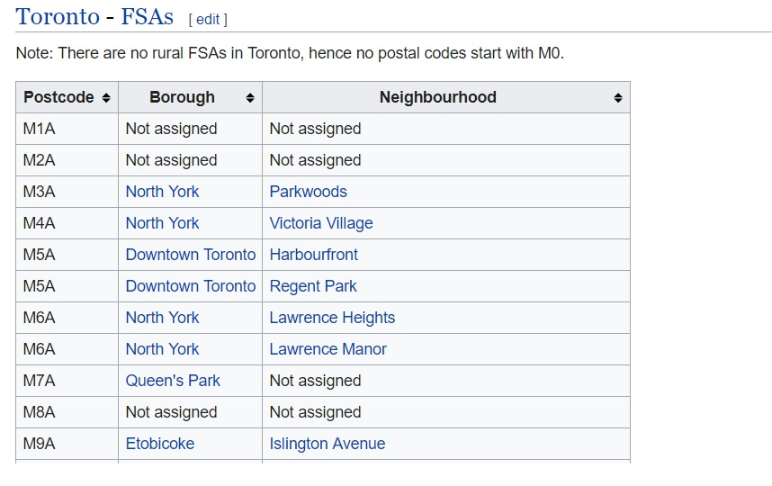
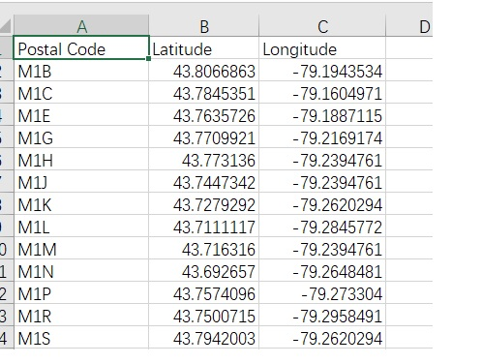
Data used:
The data required is available on the Wikipedia page and foursquare API can be used.
https://en.wikipedia.org/wiki/List_of_postal_codes_of_Canada:_M

Slide 5
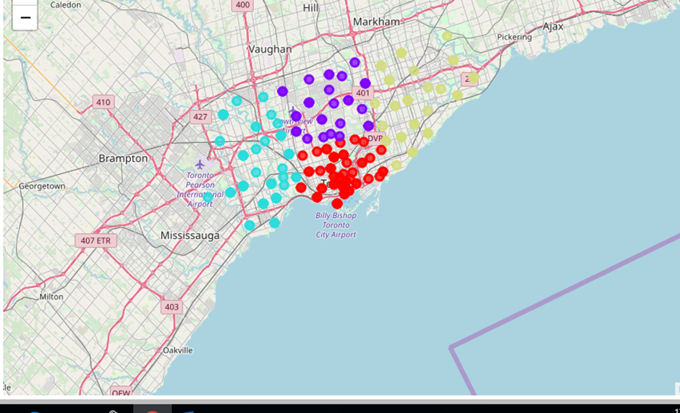
methodology
We first loaded all the Postal Codes into a data frame from a Wikipedia page , then for each postal code we fetched the co-ordinates ( latitude and Longitude).
Once this data was ready we dropped the neighborhood column and did clustering using K-MEAN algorithm.This algorithm helped us divide the region of Toronto into 54clusters , they are shown in 4 different colors

Slide 6
Once we had 5 clusters now we have to identify the locations for opening the store
Now we fetch the data related to all neighborhoods ( the venues in those neighborhood, their co-ordinates and what category they fall into). In this method we have to find it for other three clusters and then put the output results.

Slide 7
Results:
From performing the following methodology we otain the following results for the clusters as
In cluster-1 top 3 picks in this cluster are vicroria hotel, commerce court, esplanade.
In cluster-2 top three picks is choosen i.e oriole, fairview, henry farm
In cluster-3 top three picks is choosen i.e swasan,high park, junction south.
In the final cluster only top 3 has more than 10 common points , so top 3 is choosen i.e steelies west, woodbin gardens, L'Amoureax west.

Slide 8
Discussion:
As we want to start a new Asian restaurant joint in that region and there no other one we choose to fint the regions with high fallout and it can we justified using the explainations as well as we could be sure of people visiting that venues such that there is possibility of being an Asian around that region to and to let them know as prime locations gives an added advantage.
Thus, we could see that places with above results gives us an idea about spread of people in that region.so, we could end it saying it is advisable to start a restaurant over that region venues.

Slide 9
Conculsion
Finally, we can conclude by saying that the following requirements are met as defined and problem is solved accordingly using python labs and we got the exact results to where to establish the joints.
THANK YOU..

